Slide 1

Unit-4 Controlling Hardware
Internet of Things (IoT)
DU # 2101CS631
Prof. Bhushan D. Joshi
Computer Engineering Department
bhushan.joshi@darshan.ac.in
+91 8485979997

Slide 2
Actuators
Relay
Servo motor And DC motor
Stepper Motors
Bluetooth Module
Introduction to Actuators
Zigbee Module

Slide 3
Actuator
An IoT device is made up of a Physical object (“thing”) + Controller (“brain”) + Sensors + Actuators + Networks (Internet).
An actuator is a machine component or system that moves or controls the mechanism or the system.
Sensors in the device sense the environment, then control signals are generated for the actuators according to the actions needed to perform.
Actuators are the output devices like LEDs, motors, lights, and so on, which let your device do something to the outside world.
A servo motor is an example of an actuator.

Slide 4
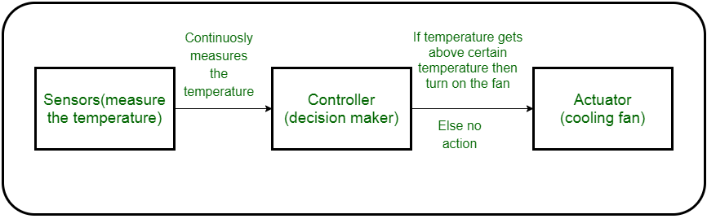
Working of Actuators
The following diagram shows what actuators do, the controller directs the actuator based on the sensor data to do the work.

Slide 5
Types of Actuators :
1.Hydraulic Actuators : A hydraulic actuator uses hydraulic power to perform a mechanical operation.
2.Pneumatic Actuators : A pneumatic actuator uses energy formed by vacuum or compressed air at high pressure to convert into either linear or rotary motion
3. Electrical Actuators : An electric actuator uses electrical energy.

Slide 6
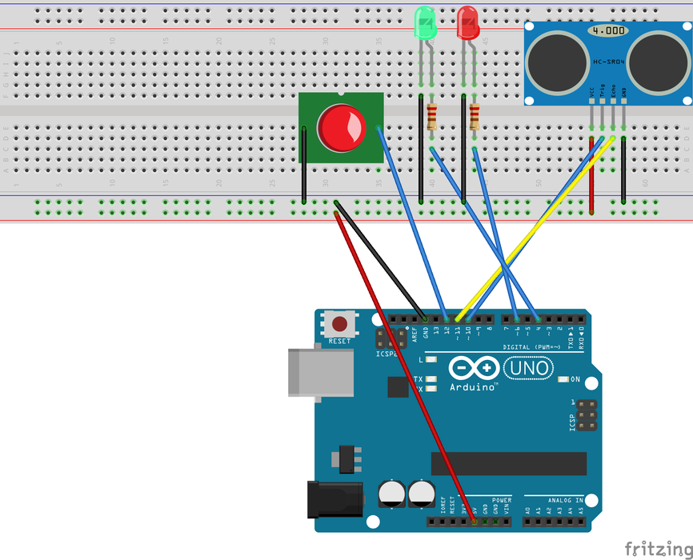
Connect LED and Buzzer with Arduino
LED and Buzzer Both are generate some output signal based on the input voltage.
LED converts Electrical Energy into the Light Energy spectrum.
Buzzer converts Electrical energy into Sound signal.
We can connect both as output device.
pinMode for both : OUTPUT.

Slide 7
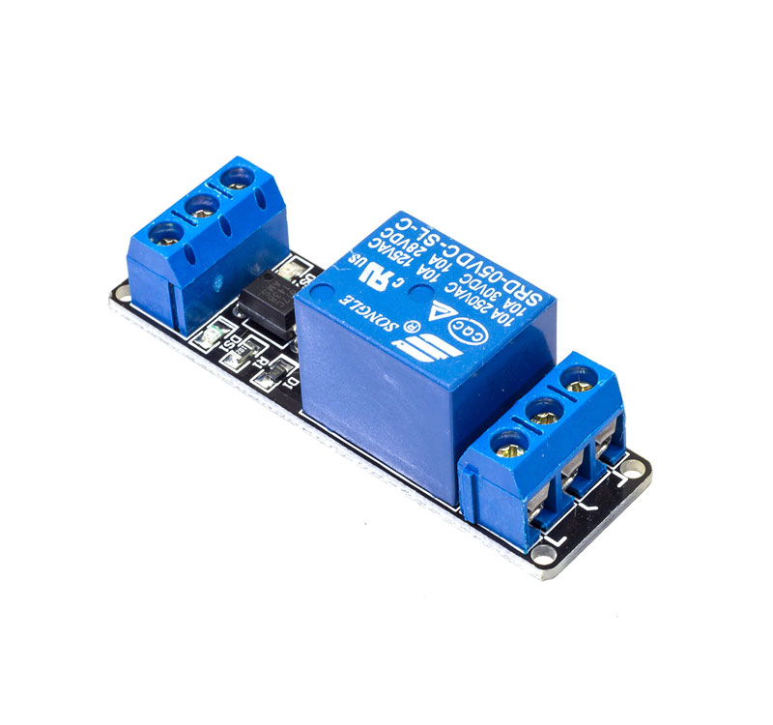
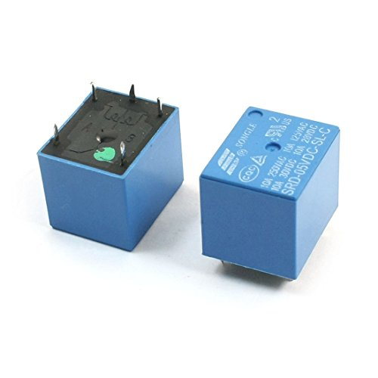
Relay
A relay is an electrically activated switch.
5V Relay Module 10A current capacity.
This small Relay Board works from a 5V signal. It uses a transistor to switch the relay on so can be connected directly to a microcontroller pin.
When the relay is not activated, the common pin is in contact with the NC pin and when it is activated, the common pin will break away from contact with the NC pin and subsequently makes contact with the NO pin.

Slide 8
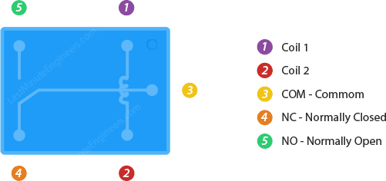
Relay Terminals

Slide 9
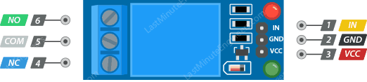
Relay Module

Slide 10
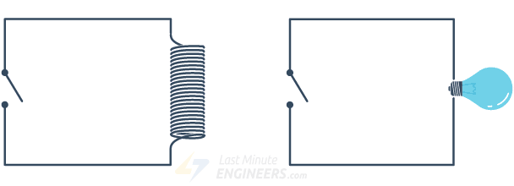
How Relay Works?
Source
Relay OFF (No coil current)
Source To NC NC=Normally Connected
Relay ON
(Current through Coil)
Source To NO NO= Normally Open

Slide 11
Relay Connection
Arduino
Relay
Vin
GND
Signal
NO
NC
Source
5v
GND
D6
Bulb
230V AC

Slide 12
Code
Relay.ino
1
2
3
4
5
6
7
8
9
10
11
12
13
14
15
16
int RelayPin = 6;
void setup() {
// Set RelayPin as an output pin
pinMode(RelayPin, OUTPUT);
}
void loop() {
// Let's turn on the relay...
digitalWrite(RelayPin, HIGH);
delay(3000);
// Let's turn off the relay...
digitalWrite(RelayPin, LOW);
delay(3000);
}

Slide 13

Applications of Relay
Commonly used in switching circuits.
For Home Automation projects to switch AC loads
To Control (On/Off) Heavy loads at a pre-determined time/condition
Used in safety circuits to disconnect the load from supply in event of failure
Used in Automobiles electronics for controlling indicators glass motors etc.

Slide 14
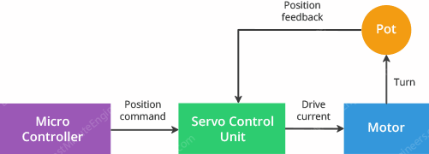
What is Servo?
Servo is a general term for a closed loop control system.
A closed loop system uses the feedback signal to adjust the speed and direction of the motor to achieve the desired result.

Slide 15
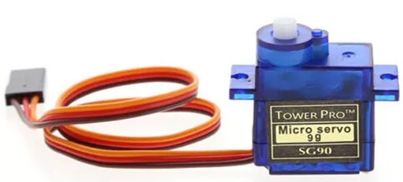
Servo Motor
A servo motor is an example of an actuator.
They are linear or rotatory actuators, can move to a given specified angular or linear position.
We can use servo motors for IoT applications and make the motor rotate to 90 degrees, 180 degrees, etc., as per our need.
A servomotor is a closed-loop servomechanism that uses position feedback to control its motion and final position.
The input to its control is a signal (either analogue or digital) representing the position commanded for the output shaft.

Slide 16
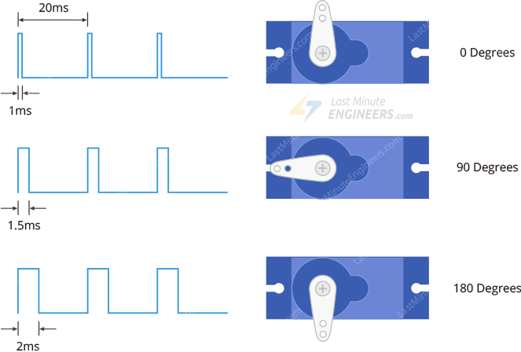
Servo Motor Working
This signal generation will be taken care of by Arduino's servo library.
All we have to do is use the servo library.

Slide 17
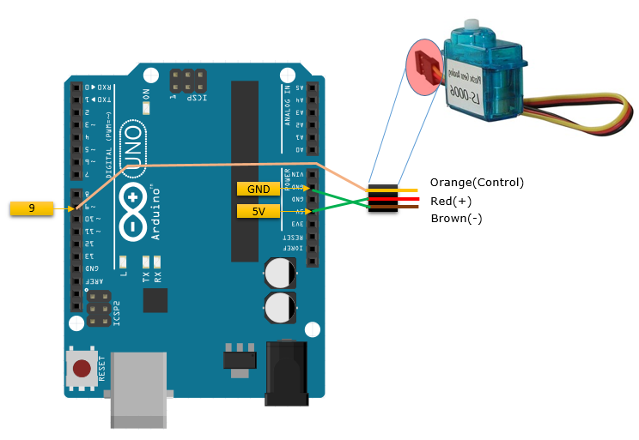
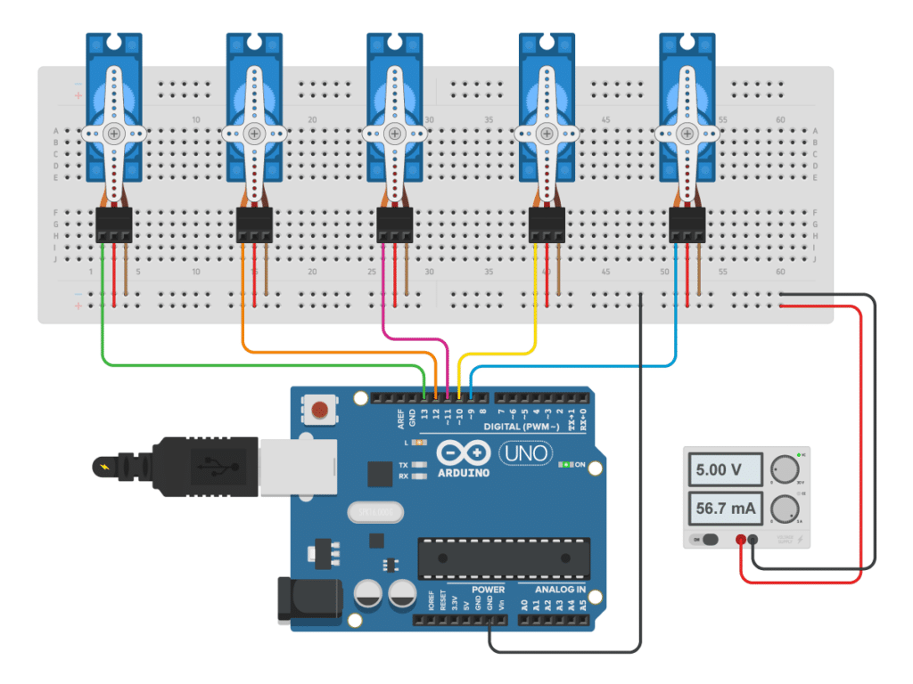
Servo Motor with Arduino

Slide 18
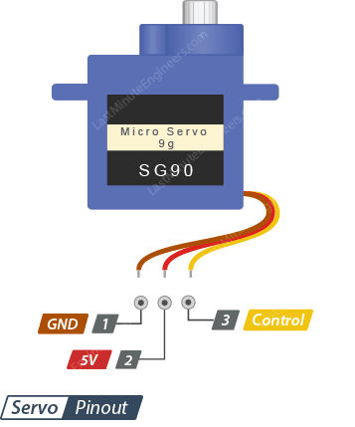
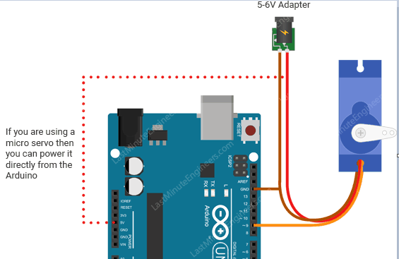
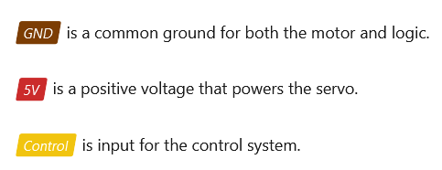
Servo Motor with Arduino

Slide 19
Servo with Arduino
There is a Servo library, which allows Arduino boards to control a variety of servo motors.
This library can control a great number of servos.
It makes careful use of timers: the library can control 12 servos using only 1 timer.
On the Arduino Due you can control up to 60 servos.
Methods
attach()// attach pin to servo variable
write()//write value to the servo motor variable for angle
read()//read the last write(); means current angle
attached()//attach servo variable to the particular pin
(Note: Arduino 0016 and earlier, the Servo library supports servos on only two pins: 9 and 10.)
detach() //If all Servo variables are detached, then pins 9 and 10 can be used for PWM output with analogWrite().

Slide 20
Servo Methods
attach() | write() | read() | attached() | detach()
Attach the Servo variable to a pin. | Writes a value to the servo, controlling the shaft accordingly. On a standard servo, this will set the angle of the shaft (in degrees), moving the shaft to that orientation. | Read the current angle of the servo (the value passed to the last call to write()). | Check whether the Servo variable is attached to a pin. | Detach the Servo variable from its pin.
Syntax servo.attach(pin) | Syntax servo.write(angle) | Syntax servo.read() | Syntax servo.attached() | Syntax servo.detach()

Slide 21
Servo Methods
attach() | write() | read() | attached() | detach()
Syntax servo.attach(pin) | Syntax servo.write(angle) | Syntax servo.read() | Syntax servo.attached() | Syntax servo.detach()
#include <Servo.h> Servo myservo; void setup() { myservo.attach(9); //attach servo to pin 9 } void loop() { } | #include <Servo.h> Servo myservo; void setup() { myservo.attach (9); myservo.write (90); // set servo to mid-point } void loop() { myservo.write (0); // set servo to start-point } | #include <Servo.h> Servo myservo; void setup() { myservo.attach (9); myservo.write (90); } void loop() { int agl; agl = myservo.read(); // return angle value //here agl = 90; } | #include <Servo.h> Servo myservo; void setup() { myservo.attach (9); myservo.write (90); // set servo to mid-point } void loop() { bool joined; joined = myservo.attached(); // return true if attached //return false if not attached } | #include <Servo.h> Servo myservo; void setup() { myservo.attach (9); } void loop() { //code myservo.detach (9); //detach Servo from //pin 9 }

Slide 22
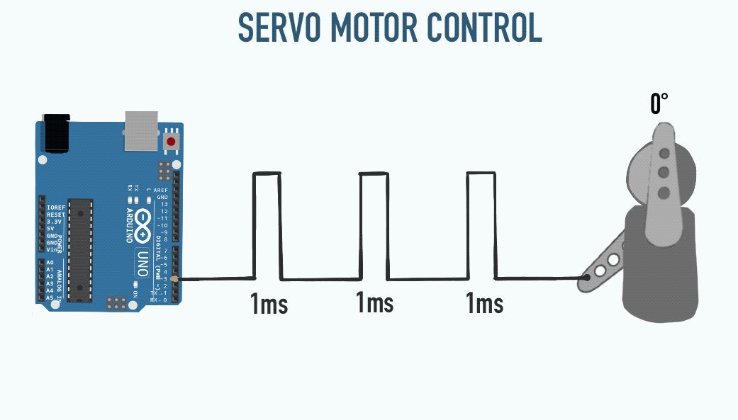
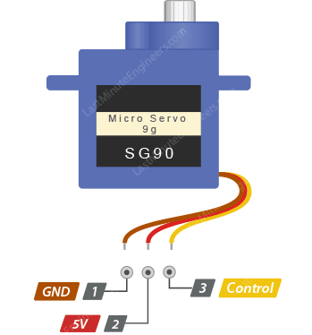
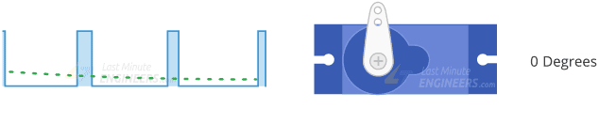
Servo motor – Code explanation
The code in Arduino for Servo motor can be written as following:
servo.ino
1
2
3
4
5
6
7
8
9
10
11
12
13
14
15
16
#include <Servo.h>
Servo darshanservo,btechservo;
void setup() {
Serial.begin(9600);
btechservo.attach(9);//attach servo to pin 9
darshanservo.attach(11);//attach servo to pin 11
}
void loop()
{
darshanservo.write(10);
btechservo.write(45);
delay(15);
}

Slide 23
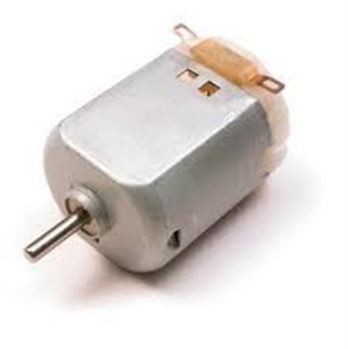
Arduino - DC Motor
There are three different type of motors −
DC motor
Servo motor
Stepper motor
A DC motor (Direct Current motor) is the most common type of motor.
DC motors normally have just two leads, one positive and one negative.
If you connect these two leads directly to a battery, the motor will rotate. If you switch the leads, the motor will rotate in the opposite direction.

Slide 24
Motor Speed Control
dcmotor.ino
1
2
3
4
5
6
7
8
9
10
11
12
13
14
15
16
int motorPin = 9;
void setup() {
pinMode(motorPin, OUTPUT);
Serial.begin(9600);
while (! Serial);
Serial.println("Speed 0 to 255");
}
void loop() {
if (Serial.available()) {
int speed = Serial.parseInt();
if (speed >= 0 && speed <= 255) { analogWrite(motorPin, speed);
}
}
}

Slide 25
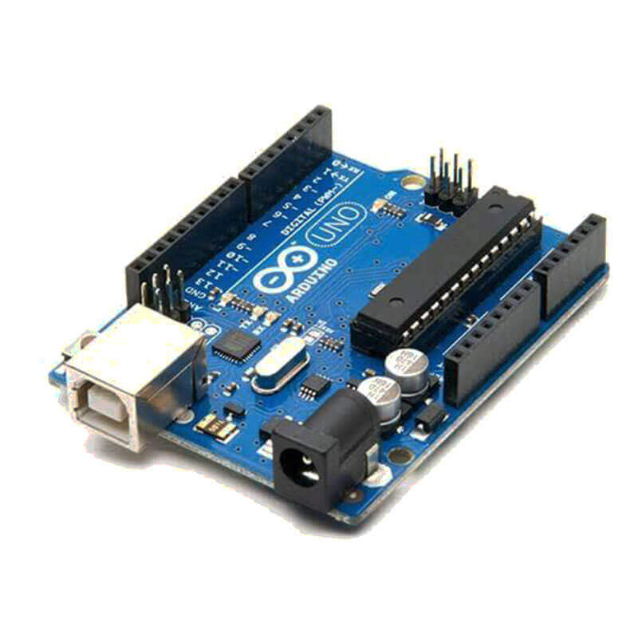
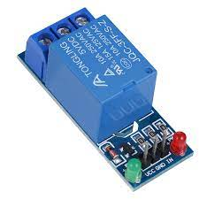
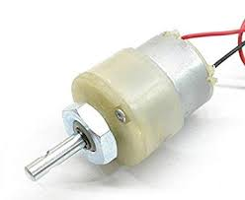
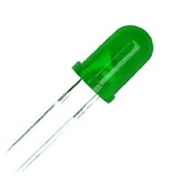
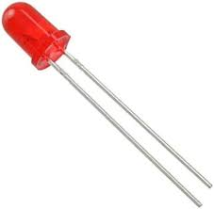
Clock Wise and Anti Clockwise Rotation

Slide 26
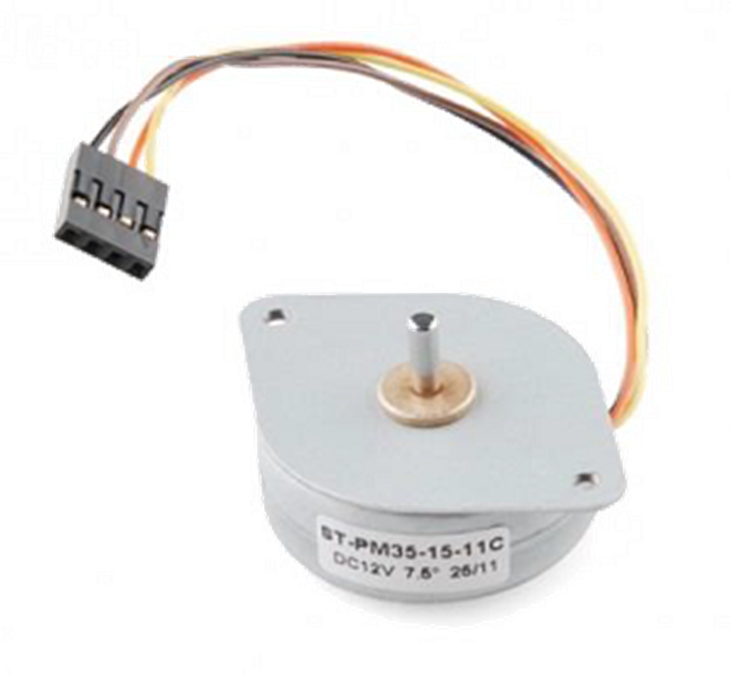
Stepper Motor
Stepper motors are often an extremely important component in a motion control system.
A Stepper Motor or a step moto divides a full rotation into a number of steps.
A brushed DC motor rotates continuously when a fixed DC voltage is applied to it, while a step motor rotates in discrete step angles.
The Stepper Motors therefore are manufactured with steps per revolution of 12, 24, 72, 144, 180, and 200, resulting in stepping angles of 30, 15, 5, 2.5, 2, and 1.8 degrees per step.
The stepper motor can be controlled with or without feedback.
The motor spins very fast in one direction or another.
We can vary the speed with the amount of power given to the motor, but we cannot tell the propeller to stop at a specific position like servo motor.

Slide 27
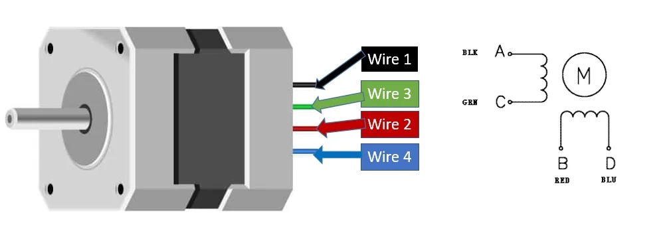
Bipolar Stepper Motor
Bipolar Stepper Motor :
Motors always have 2 coils and 4 wires.
By driving the current in separate directions through each of the coils, we can have a total of 4 different states:
Coil A current flowing ‘left to right’.
Coil A current flowing ‘right to left’.
Coil B current flowing ‘left to right’.
Coil B current flowing ‘right to left’.
Pin No | Name | Name | Colour
1 | A | A+ | Black
2 | C | A- | Green
3 | B | B+ | Red
4 | D | B- | Blue
Terminals
Coil A and Coil B

Slide 28
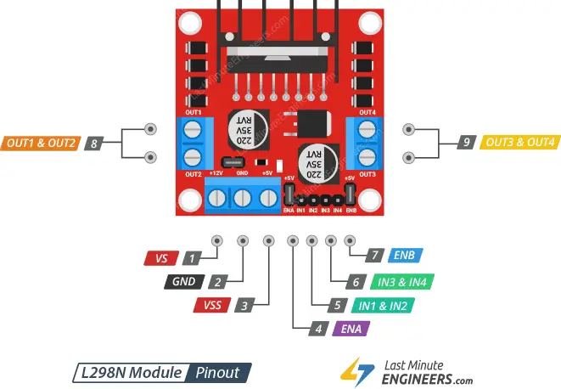
L298N : Driving IC
L298N is a Motor Driver Chip.
The L298N chip contains two standard H-bridges capable of driving a pair of DC motors or single Stepper motor making it ideal for building a robotic platform.
Power Pins:
VS pin powers the IC’s internal H-Bridge, which drives the motors. This pin accepts input voltages ranging from 5 to 12V.
VSS is used to power the logic circuitry within the L298N IC, and can range between 5V and 7V.
GND is the common ground pin.

Slide 29
L298N : DC Motor
Output Pins :
Two DC Motor:
The output channels of the L298N motor driver:
OUT1 and OUT2 for motor A
OUT3 and OUT4 for motor B.
We can connect two 5-12V DC motors to these terminals.

Slide 30
L298N : Stepper Motor
Stepper Motor:
For which ever stepper motor you are using refer to its datasheet to find the correct colored wires to differentiate the A+, A-, B+ and B- wires. This will enable us to properly connect the motor with the OUT1, OUT2, OUT3 and OUT4 pins of the driver module.
Black wire = A+ → OUT1
Green wire = A- → OUT2
Red wire = B+ → OUT3
Blue wire = B- → OUT4
Connect positive terminal of 12V power supply with 12V terminal and negative with common ground.

Slide 31
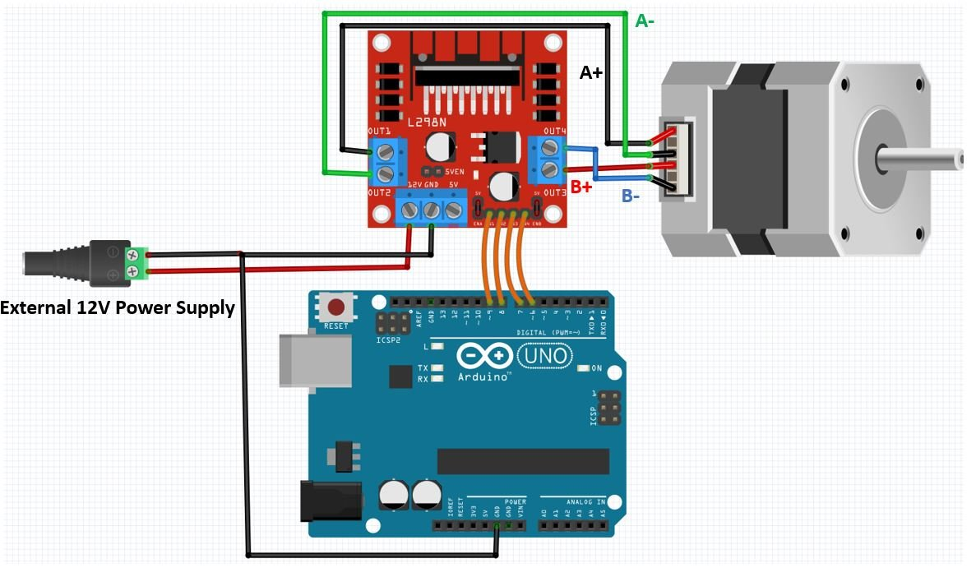
Bipolar Stepper Motor Connection With Arduino UNO & LM298
Connection with Arduino:

Slide 32
Code
Stepper.ino
1
2
3
4
5
6
7
8
9
10
11
12
13
14
15
/* Stepper Motor Control - one revolution
This program drives a unipolar or bipolar stepper motor.
The motor is attached to digital pins 8 - 11 of the Arduino.
The motor should revolve one revolution in one direction, then one revolution in the other direction. */
#include <Stepper.h>
const int stepsPerRevolution = 200;
// change this to fit the number of steps per revolution
#define IN1 9
#define IN2 8
#define IN3 7
#define IN4 6
// initialize the stepper library on pins 6 through 9:
Stepper myStepper(stepsPerRevolution, IN1, IN2, IN3, IN3); //200 steps

Slide 33
Code
Stepper.ino
15
16171819202122232425262728
void setup() {
myStepper.setSpeed(60); // set the speed at 60 rpm:
Serial.begin(9600); // initialize the serial port: 9600 baud rate
}
void loop() {
// step one revolution in one direction:
Serial.println("clockwise");
myStepper.step(stepsPerRevolution); //+ve Clockwise
delay(500);
// step one revolution in the other direction: Serial.println("counterclockwise");
myStepper.step(-stepsPerRevolution); //-ve Counter clockwise
delay(500);
}

Slide 34
Arduino with Bluetooth Module
Bluetooth is everywhere nowadays. It’s a word we hear all the time and is in millions of products we use everyday, including headsets, cellphones, laptops, game controllers, activity trackers, and so on.
One of the most affordable and widely used Bluetooth modules is the HC-05.
HC-05 Hardware Overview
The HC-05 is a Bluetooth-to-Serial-Bridge module that allows wireless communications between two microcontrollers or between a microcontroller and a smartphone, laptop, or desktop PC with Bluetooth capability.
It’s perfect for directly replacing a wired asynchronous serial interface.
Each of these modules contains a Bluetooth transceiver, meaning they’re capable of both sending and receiving data.

Slide 35
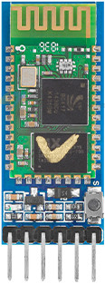
Bluetooth Module : HC-05
HC-05 is Class 2 Bluetooth device.
HC-05 has a nominal range of 10 m.
HC-05 module has a 3.3V logic level.
There’s no need to mess with Bluetooth protocols or the stack. Just send data over a serial interface, and it’s piped through to whatever Bluetooth device it’s connected to.

Slide 36
HC-05: Modes of Operation
Basic Two Operation:
Controlling the HC-05 module
Sending user data through module
Both operation accomplished through the serial interface.
Operation
Controlling
Exchange Data
Arduino Board
HC-05
Bluetooth

Slide 37
HC-05 Pinout (6 Pin)
STATE pin can be used to determine the current status of the HC-05 module.
The State pin is LOW when the module is not paired and HIGH when it is.
RXD pin receives serial data from the microcontroller. It should be connected to the TX of the microcontroller. Please note that this pin is not 5V-tolerant. Therefore, before connecting the module to a 5V microcontroller, the microcontroller’s Tx signal must be stepped down to 3.3V.
TXD pin sends serial data to the microcontroller. It should be connected to the RX of the microcontroller.
GND is the ground pin, common to any other device connected to the module.
VCC is where you connect the positive supply voltage. This voltage supply signal is routed to the HC-05 chip via a 3.3V regulator. It should range from 3.6V to 6V.
EN is connected to the on-board regulator enable pin and is pulled high by a 220k resistor. Pulling this pin low disables the regulator, which consequently turns off the HC-05.

Slide 38
HC-05 vs HC-06
The HC-05 and HC-06 are Bluetooth modules for Arduinos that differ in their programming and mode.
The HC-05 can act as both a master and a slave device.
The HC-06 can only act as a slave device.
The HC-05 is also easier to program than the HC-06.

Slide 39
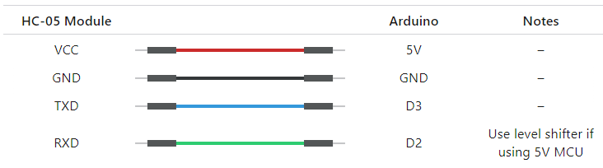
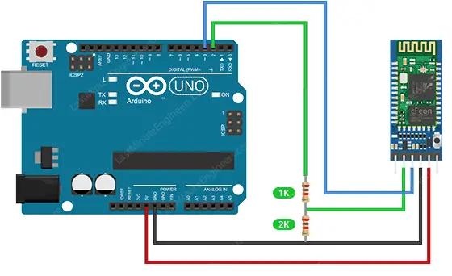
Wiring a HC-05 Module to an Arduino
Software Serial Port
to avoid bus contention and ensure that the HC-05 doesn’t receive any unintended data during a sketch upload.

Slide 40
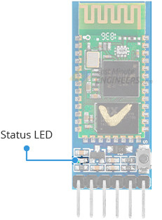
Status LED
Many HC-05 modules come with an onboard LED.
LED blinks at various rates to indicate the status:
When powered up, the module enters Bluetooth pairing mode, with the LED flashing rapidly at about 2 Hz.
When the module is paired with a device, the LED flash pattern changes to two quick flashes, followed by a pause, and then repeats.
When the module is put into AT mode, the LED blinks at a slow and steady rate.
Default Baud rate for AT mode is 38400 bps, but it can be changed if necessary.

Slide 41
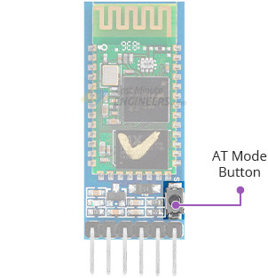
AT - Mode
AT Mode is the configuration mode.
With sending Hayes AT-style commands to the HC-05 module we can change its settings like name, baud rate, password, etc.
Normally, the HC-05 module is in data mode.
To put it into AT mode, we need to press-and-hold the onboard button while powering up the module.
The LED will then start blinking at a slow and steady rate, indicating that the module is in AT mode.
Once in AT mode, we can send AT commands to the module over the UART port.
The module will respond to the commands, either by acknowledging the command, providing the requested data, or signaling an error.

Slide 42
AT-Mode
AT commands are essentially modem instructions.
Originally developed by the modem maker Hayes as means to operate their dial-up landline products.
AT commands — the 'AT' stands for 'come to ATtention' — are now used by all modems, of all types.
The commands usually start with “AT+” followed by the specific command.
“AT+NAME?” queries the name of the module.
“AT+NAME=MyHC05” changes the name to “MyHC05”

Slide 43
HC-05
AT : Check the connection.
AT+NAME : See default name or Set Name
AT+ADDR : see default address
AT+VERSION : See version
AT+UART : See baudrate or Set Baud rate
AT+ROLE: See role of bt module(1=master/0=slave)
AT+RESET : Reset and exit AT mode
AT+ORGL : Restore factory settings
AT+PSWD: see default password

Slide 44
HC-06
AT+NAME: Change name. No space between name and command.
AT+NAMEPROTOTYPE will set the name to PROTOTYPE.
AT+BAUD: change baud rate, x is baud rate code, no space between command and code.
To change baud rate, type AT+BAUDX, where X=1 to 9.
1 set to 1200bps 2 set to 2400bps 3 set to 4800bps 4 set to 9600bps (Default) 5 set to 19200bps 6 set to 38400bps 7 set to 57600bps 8 set to 115200bps so sending AT+BAUD4 will set the baud rate to 9600.

Slide 45
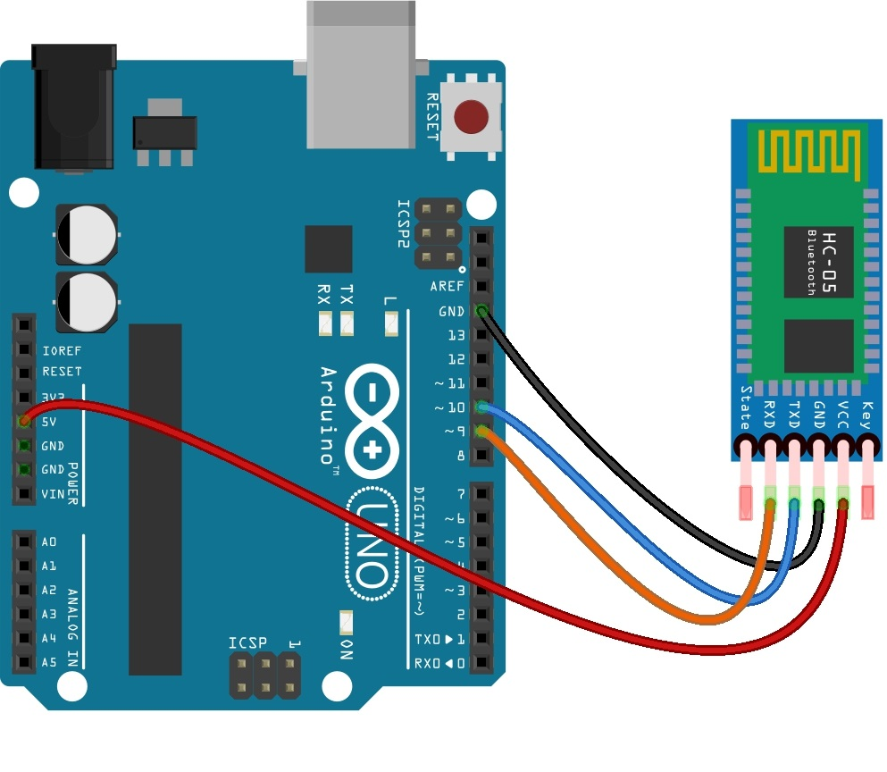
Data Mode
In Data Mode, the HC-05 module acts as a transparent data gateway.
When the HC-05 receives data, it removes the Bluetooth headers and trailers and sends it to the UART port.
When data is written to the UART port, the HC-05 constructs a Bluetooth packet and sends it over the Bluetooth wireless connection.

Slide 46
Serial Communication with Bluetooth Module
The code in Arduino for Serial communication for Bluetooth Module can be written as following:
bluetooth.ino
1
2
3
4
5
6
7
8
9
10
11
12
13
14
15
#include <SoftwareSerial.h>
//Create software serial object to communicate with HC-05
SoftwareSerial mySerial(3, 2);
//HC-05 Tx & Rx is connected to Arduino #3 & #2
void setup() {
//Begin serial communication with Arduino and Arduino IDE Serial Monitor
Serial.begin(9600);
//Begin serial communication with Arduino and HC-05
mySerial.begin(9600);
Serial.println("Initializing...");
Serial.println("The device started,now you can pair it with bluetooth!");
}

Slide 47
Serial Communication with Bluetooth Module
servo.ino
16
17
18
19
20
21
22
23
24
25
26
27
28
29
30
void loop() {
if(Serial.available())
{
mySerial.write(Serial.read());
//Forward what Serial received to Software Serial Port }
if(mySerial.available())
{
Serial.write(mySerial.read());
//Forward what Software Serial received to Serial Port }
delay(20);
}

Slide 48
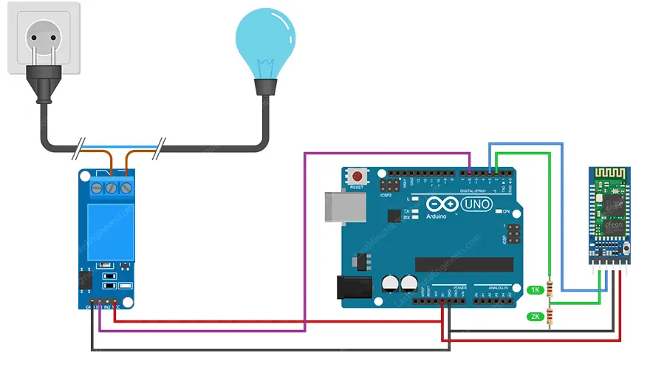
Bluetooth-Controlled Relay Example
Control relays wirelessly using Bluetooth can be useful for home automation, smart lighting, security systems, and other similar applications.

Slide 49
Serial Communication with Bluetooth Module
The code in Arduino for Serial communication for Bluetooth Module can be written as following:
bluetooth.ino
1
2
3
4
5
6
7
8
9
10
11
12
13
14
15
#include <SoftwareSerial.h>
// GPIO where relay is connected to
const int relayPin = 6;
// Handle received messages
String message = "";
// Create software serial object to communicate with HC-05
SoftwareSerial mySerial(3, 2);
//HC-05 Tx & Rx is connected to Arduino #3 & #2
void setup() {
// Begin serial communication with Arduino and Arduino IDE (Serial Monitor) Serial.begin(9600);

Slide 50
Serial Communication with Bluetooth Module
The code in Arduino for Serial communication for Bluetooth Module can be written as following:
bluetooth.ino
16
17
18
19
20
21
22
23
24
25
26
27
28
29
30
// Initialize relayPin as an output
pinMode(relayPin, OUTPUT);
digitalWrite(relayPin, LOW);
//Begin serial communication with Arduino and HC-05
mySerial.begin(9600);
Serial.println("Initializing...");
Serial.println("The device started, now you can pair it with bluetooth!");
}
void loop()
{
if (mySerial.available()){
char incomingChar = mySerial.read();
if (incomingChar != '\n'){
message += String(incomingChar);
}

Slide 51
Serial Communication with Bluetooth Module
The code in Arduino for Serial communication for Bluetooth Module can be written as following:
bluetooth.ino
31
32
33
34
35
36
37
38
39
40
41
42
43
44
45
else {
message = "";
}
Serial.write(incomingChar);
}
// Check received message and control output accordingly
if (message == "on"){
digitalWrite(relayPin, HIGH);
}
else if (message == "off"){
digitalWrite(relayPin, LOW);
}
delay(20);
}

Slide 52
Zigbee/XBee Module with Arduino and NodeMCU
Zigbee is a popular wireless communication protocol used to transfer a small amount of data with very low power.
It is widely used in applications where data has to be shared among many nodes within personal space and with the advent of the Internet of things (IoT).
XBee is a module, a product, which supports many wireless communication protocols like ZigBee, 802.15.4, 868 MHz modules, etc.
Zigbee is a standard protocol used to establish wireless networking (ZigBee communication).
To establish Zigbee communication:
A receiver (endpoint)(receive data) and transmitter (coordinator) (Send Data).
XBee module connected with Arduino/NodeMCU which works either as endpoint or coordinator
Xbee
Xbee
Arduino-1
(Coordinator)
Arduino-2
(End-Point)

Slide 53
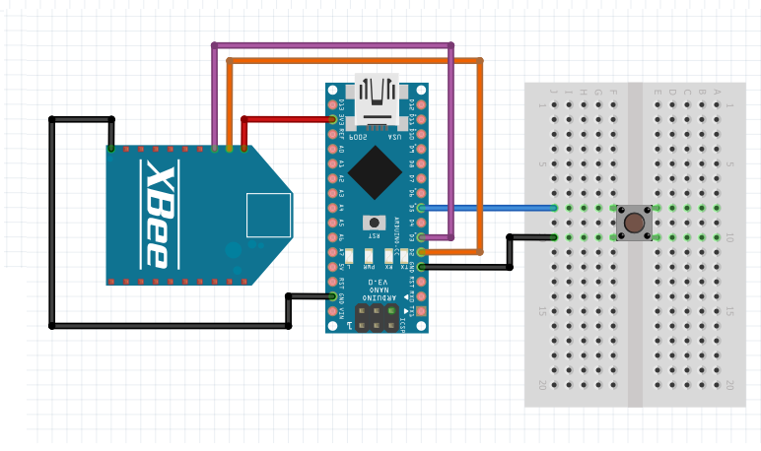
Interfacing XBee With Arduino (Transmitting Side)
Connect VCC (pin 1) of XBee module to 3.3V of Arduino Nano .
GND (pin 10) of XBee to GND of Arduino Nano.
These two connections make up for powering the transmitting side XBee module.
Connect Dout (pin 2) to D2 of Arduino Nano.
Din (pin 3) to D3 of Arduino Nano.
Pushbutton Connected to D5.
Active Low.(INPUT_PULLUP)

Slide 54
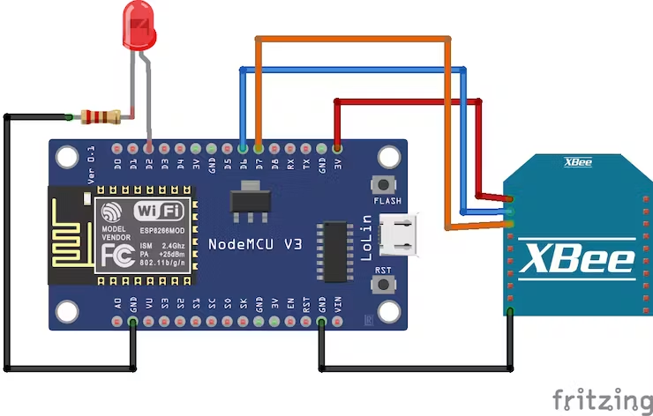
Interfacing XBee With NodeMCU (Receiving Side)
Connect Gnd(pin10) of XBee to GND of NodeMCU.
Connect Vcc (Pin1) of XBee to 3.3V of NodeMCU.
The above-mentioned two connections supply the power to the XBee module as well.
Then connect Dout (pin2) of XBee to D6 pin of NodeMCU and Din (pin3) of XBee to D7 pin of NodeMCU for receiving data.
As an indication of whether the data is received or not, we’ve used LED.
For this, connect LED anode to D2 of NodeMCU and LED cathode to GND through a 220ohm resistor of NodeMCU.

Slide 55
Configure and testing of XBee devices
Need XCTU software.
It’s an easy-to-use, free, multi-platform application for RF XBee modules.
Download the XCTU software and install it as well.
After that, open the application and connect XBee using a USB to serial converter or an explorer board.
Check the COM port of the Xbee in the device manager.
Configure And Update Both Xbee Board.

Slide 56
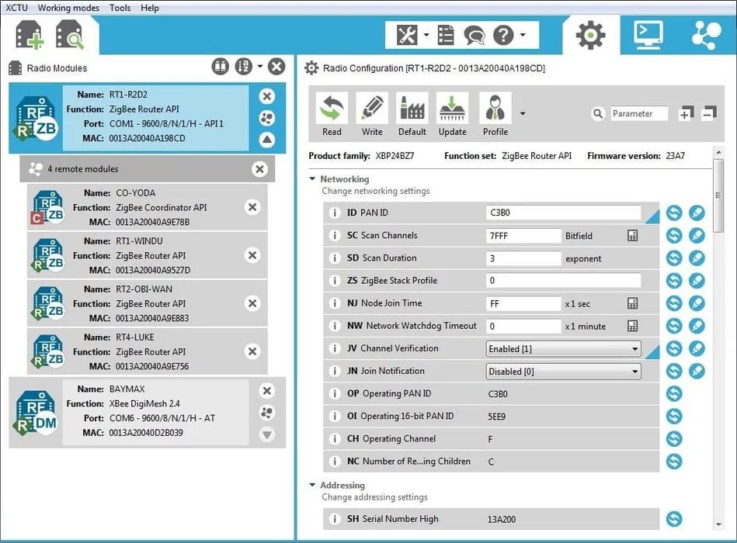
XCUT

Slide 57
Serial Communication with Xbee Module (Tx)
The code in Arduino for Serial communication for Xbee Module can be written as following:
Xbee.ino
1
2
3
4
5
6
7
8
9
10
11
12
13
#include "SoftwareSerial.h"
SoftwareSerial XBee(2,3);
int BUTTON = 5;
boolean toggle = false;
//this variable keeps track of alternative click of the button
void setup() {
Serial.begin(9600);
pinMode(BUTTON, INPUT_PULLUP);
XBee.begin(9600);
}

Slide 58
Serial Communication with Xbee Module (Tx)
Xbee.ino
16
17
18
19
20
21
22
23
24
25
26
27
28
29
30
void loop() {
//When button is pressed (GPIO pulled low) send 1
if (digitalRead(BUTTON) == LOW && !toggle) {
Serial.println("Turn on LED");
toggle = true;
XBee.write('1');
delay(1000); }
//When button is pressed second time (GPIO pulled low) send 0
else if (digitalRead(BUTTON) == LOW && toggle) { Serial.println("Turn off LED");
toggle = false;
XBee.write('0');
delay(1000); }
}

Slide 59
Serial Communication with Xbee Module (Rx)
The code in Arduino for Serial communication for Xbee Module can be written as following:
Xbee.ino
1
2
3
4
5
6
7
8
9
10
11
12
13
#include<SoftwareSerial.h>
int led = 2;
int received = 0;
int i;
//For communicating with zigbee
SoftwareSerial zigbee(13,12);
void setup() {
Serial.begin(9600);
zigbee.begin(9600);
pinMode(led, OUTPUT);
}

Slide 60
Serial Communication with Xbee Module(Rx)
The code in Arduino for Serial communication for Xbee Module can be written as following:
Xbee.ino
14
15
16
17
18
19
20
21
22
23
24
25
26
27
void loop() {
//check if the data is received
if (zigbee.available() > 0) {
received = zigbee.read();
//if the data is 0, turn off the LED
if (received == '0') {
Serial.println("Turning off LED");
digitalWrite(led, LOW);}
//if the data is 1, turn on the LED
else if (received == '1') {
Serial.println("Turning on LED");
digitalWrite(led, HIGH); }
}
}

Slide 61
Internet of Things (IoT)
DU #2301OE003
Prof. Bhushan D. joshi
Computer Engineering Department
bhushan.joshi@darshan.ac.in
+91 8485979997

